Slide 1


Embracing the E-commerce Revolution in Asia and the Pacific
Tengfei WANG
Economic Affairs Officer
Trade, Investment and Innovation Division
United Nations Economic and Social Commission for Asia and the Pacific
The presentation is mainly based on a joint ADB-ESCAP report titled “Embracing the E-commerce Revolution in Asia and the Pacific”. Jong Woo Kang from ADB and Tengfei Wang from ESCAP led the preparation of the report

Slide 2
Key messages
  E-commerce revolution in Asia and the Pacific presents vast economic potential
  E-commerce market in the region remains highly heterogeneous in (i) economic factors and conditions, (ii) legal and institutional environment and (iii) social acceptance
  The emergence of new technologies will significantly impact the e-commerce landscape
  Border procedures and regulatory burdens should improve to foster cross-border e-commerce
  Developing an e-commerce ecosystem requires a holistic approach and concerted efforts by all stakeholders

Slide 3
Factors Affecting the Development of E-marketplace
Economic
Social Acceptance and Awareness
● Affordability and access to ICTs
● Bandwidth availability
● Availability of online payment options
● Delivery infrastructures
● Economies of scale
Firm level
● Confidence, risk aversion, and inertia
● Awareness, knowledge and understanding of e-commerce opportunities
Consumer level
● Awareness and knowledge of e-commerce benefits
● General and computer literacy
● English proficiency
● Trust in e-commerce vendors and postal services
● Perception of foreign products/vendors
Individual
readiness
for e-commerce
E-marketplace
development
Environmental
readiness
for e-commerce
Legitimacy to
participate in
e-commerce
Legal and Institutional
Normative institutions
● Importance of personal relationships in business
● Roles played by industry bodies and trade/professional associations
Regulative institutions
● Legislative measures related to
e-commerce
● Measures making e-commerce affordable and accessible
● Policy initiatives that directly facilitate e-commerce activities
● Public-private partnership
programs
Economic
Legal and Institutional
Social Acceptance and Awareness
Economic environment that affects accessibility and viability of
e-commerce activities
Social and political environment that plays roles in the evolution of the legitimacy of e-commerce-related activities
Internalized norms that affect
e-commerce-related behaviors of individuals and organizational decision-makers
ICT = information and communications technology.
Source: ADB compilation based on Kshetri (2007a, 2018a), North (1996), Parto (2005), Scott (1995, 2001), and World Bank (2016a).

Slide 4
Asia and the Pacific is the largest and fast growing e-commerce market
Comparison of Internet Retailing Market Size, 2017-2021 (forecast)
Note: Market size refers to the total goods and services sold through internet retail market. See Box 1.1 for the definition of internet retailing. Asia and the Pacific comprises of Australia; Azerbaijan; Hong Kong, China; India; Indonesia; Japan; Kazakhstan; Malaysia; New Zealand ; the People’s Republic of China; the Philippines; Singapore; the Republic of Korea; Taipei,China; Thailand; Uzbekistan; and Viet Nam.
Source: Kshetri (2018) using data from Euromonitor International. Passport database.
Notes:
Asia and the Pacific also does well in terms of the market size of internet retailing, a subset of B2C e-commerce (Figure 1.3). In 2017, the combined internet retailing market share of Asia and the Pacific was already above that of North America and Europe combined. According to Euromonitor International, the global internet retailing market share of Asia and the Pacific will reach 48.5% of the global total in 2021 compared with 47.2% in 2017 (Kshetri 2018a).

Slide 5
It is also the largest as % of GDP
Global E-commerce
(% of GDP)
Regional E-commerce, 2015
(% of GDP)
GDP = gross domestic product.
Note: Business-to-Consumer (B2C) e-commerce covers any contract for the sale of goods and/or services, fully or partially concluded by a technique for distance communication. Values refer to the total of goods and services sold through B2C transactions as a percentage of GDP.
Source: Ecommerce Foundation (2016).
Notes:
E-commerce is clearly growing in economic activities (Figure 1.2). The share of e-commerce in global gross domestic product (GDP) rose from 1.3% in 2011 to 3.1% in 2015. Its contribution to the economy is most prominent in the Asia and Pacific region. By the end of 2015, the size of e-commerce relative
to GDP was 4.5% in Asia and the Pacific—the highest among regions globally. In comparison, the share of e-commerce in regional GDP stood at 3.1% and 2.6% in North America and Europe, respectively. E-commerce held even lower shares in Latin America (0.8% of regional GDP) and the Middle East and North Africa (0.7%).

Slide 6
ICT Infrastructure
Key ICT Indicators by Region, 2016 (per 100 inhabitants)
Source: International Telecommunication Union. Statistics. https://www.itu.int/en/ITU-D/Statistics/Pages/stat/default.aspx
Mobile and Fixed Broadband Speed—Central and West Asia, South Asia, and Southeast Asia,
as of December 2017 (megabits per second, download)
Source: Speedtest. Speedtest Global Index December 2017. http://www.speedtest.net/global-index
Notes:
While the availability of broadband internet connections has been a key factor in fueling its growth, e-commerce requires substantial ICT infrastructure that allows sellers to transact business with buyers. Figure 3.2 presents key ICT indicators—fixed and mobile telephone, computer, and the internet penetration levels. It shows that developing economies and LDCs perform poorly compared with developed countries in terms of the economic and infrastructural factors needed to participate in e-commerce. Notably, all groups show an inclination toward mobile versus fixed telephone subscriptions, as well as an inclination toward mobile broadband subscriptions versus fixed broadband subscriptions.
Figure 3.3 uses the same indicators as above, but with economies grouped by region. It also shows that, across all regions, mobile subscriptions are more prevalent to fixed subscriptions, and that mobile broadband subscriptions are more widely used than fixed broadband subscriptions. Asia and the Pacific performs better than Africa and Arab States in most indicators, but lags behind other regions.7
Figure 3.6 shows the low bandwidth availability in LDCs and developing countries in Central and West Asia, South Asia, and Southeast Asia. A lower bandwidth means a longer time is needed to transfer data and hence low relative advantage of using the internet and e-commerce. By region, in 2016, the international internet bandwidth per internet user in Asia and the Pacific was 48 kilobit per second (KBPS), below Africa’s 51 KBPS. As a region, only the Arab States had lower international internet bandwidth per internet user (39 KBPS) than Asia and the Pacific. For comparison, developing economies’ international internet bandwidth
per internet user stood at 53 KBPS (ITU 2017).9

Slide 7
E-payment
Card Payment Transactions—Selected Asian Economies, 2016
($ per capita)
Source: Kshetri (2018a) using data from Euromonitor International. Passport database.
Notes:
Figure 3.8 presents per capita credit card transactions as well as total card payment transactions for selected Asian economies (Kshetri 2018a).10 Across the region there are large differences in the use of credit cards and other online forms of payment. The top four economies in the region spend around 200 times the bottom four economies in credit card transactions per capita. For instance, the Republic of Korea’s per capita credit card spending is 306 times that of India’s. Across all types of cards, consumers from the Republic of Korea outspend their Indian counterparts by a wide margin. These differences partly explain why some markets have a more developed e-commerce industry and market than others.
Studies suggest that, due to lack of preferred payment options being offered, about 24%–25% of online shoppers abandon their virtual shopping baskets before completing online purchases (BI Intelligence 2014, Paypal 2018). This is a major concern as most LDCs and developing countries have low credit and debit card penetration rates.

Slide 8
Delivery Infrastructure
Population with Access to Home Mail Delivery—
Selected Asian Economies, 2015 (% of population)
Source: Universal Postal Union. http://www.upu.int/en/ressources/statistiques-postales/resultats-2015.html
Notes:
Figure 3.11 shows the proportion of people that have mail delivered to their homes.13 Japan and Uzbekistan come out on top with 100% having access. In contrast, only 2% of Tonga’s population can avail of the service.

Slide 9
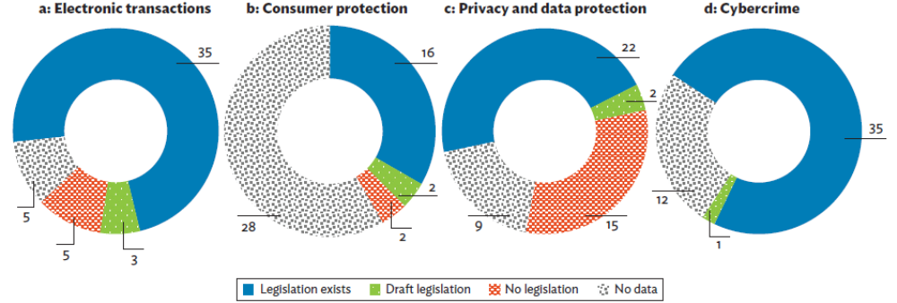
Legislation
Status of E-commerce Legislation—Asia and the Pacific,
as of December 2017 (Number of economies)
Sources: Various international and local sources.
Notes:
Figure 3.13 illustrates the number of Asia and Pacific economies at various stages of legislation affecting e-commerce.20 Most economies have some type of electronic transaction and cybercrime legislation, while many are lax when it comes to privacy and data protection and consumer protection laws.

Slide 10
Economic Benefits and Costs of
Using E-commerce
Benefits | Costs
Boosts efficiency and increases gross domestic product Allows economies to increase participation in global value chains Increases labor productivity and supports job creation, entrepreneurship, innovation, and creativity Leads to energy savings and lower carbon emissions Advances inclusive growth (benefitting developing economies, rural areas, women and the elderly, among others) | Requires social and physical capital investment Could lead to transfer pricing and erosion of tax revenue Potential to widen economic disparity Potential to distort competition
Source: ADB compilation based on Anvari and Norouzi (2016); Bram and Gorton (2017); Ca’ Zorzi (2000); Carnegie Melon University (2009); Cockfield et al. (2013); Hinojosa (2017); Mueller and Shoenmaker (2007); Organisation for Economic Co-operation and Development, United Nations Conference for Trade and Development (UNCTAD), and World Trade Organization (2016); Palsson, Pattersson, and Hiselius (2017); Savrul and Kılıç (2011); UNCTAD (2015, 2017b); and World Bank (2003, 2016b).

Slide 11
Enhancing Inclusiveness
  Rapid growth in internet and mobile phone access
  Developments in e-payment
  Improving logistics-related technologies and infrastructure to benefit the disadvantaged
  E-commerce-enabling technologies in developing countries and LDCs
  Improved access to advanced e-commerce-enabling technologies for SMEs

Slide 12
Emerging Technologies affecting
E-commerce Landscape
Big Data Use in the People’s Republic of China to Boost Customer Retention and Spending
Collect data:
● Online shoppers
● Available products
● Purchasing habits of online shoppers
Use data:
● Identify customer groups
● Use machine learning to decide on product lines and promotions
Increase customer retention and spending:
● Segment customer groups
● Target offerings
Source: ADB based on Wang (2016)
Average Sensor Cost for the Internet of Things—Global ($ per unit)
Source: BI Intelligence (2014)

Slide 13
Emerging Technologies affecting
E-Commerce Landscape
Technology | Examples of use | Benefits of combining with 5G
IoT | IoT can improve consumer experience, track inventory in real-time and manage more effectively (e.g., JD.com) | 5G's faster data-transmission will make it easier to transfer data created by IoT devices.
AI | AI-enabled apps—such as Amazon and Google assistant—can order products online, track orders and perform other e-commerce activities. | 5G's faster data-transmission will allow quicker access to additional information and help the AI better understand the environment and context.
Blockchain | Blockchain-based smart contracts can be used by online vendors to automate order fulfillment. Blockchains have been used in supply chain management systems and B2B e‐commerce (e.g. the PRC’s JD.com). | 5G can help feed information (e.g., from IoT devices) required for a smart contract more efficiently. It can also provide better security.
AR/VR | AR enabled apps allow a potential customer to place real products in a virtual setting to provide clear visualization of product use (e.g., Lego and IKEA). | 5G network’s higher bandwidth, reduced latency and greater uniformity (mobile connection’s consistency across locations) allows transmission of complex worlds and sophisticated inputs that require processing of huge amounts of data.
Source: ADB compilation based on Dave (2017), Harbet (2018), IDG (2018), and Xiao (2017).

Slide 14




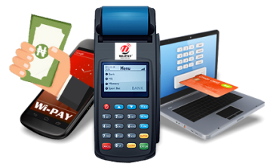
E-commerce boosts efficiency, enhances market access for businesses and consumers, and generates spillover effects
To unlock the potential of digital trade and e-commerce,
it is imperative to take on the following measures:
Institute legal, regulatory and institutional reforms
Enhance affordability
of and access to ICT
Improve logistics and delivery infrastructure
Intensify regional efforts to modernize and harmonize regulations
Broaden the e-payment availability and options

Slide 15
Creating a Virtuous Cycle in E-marketplace Development
Government agencies and
trade associations
Create institution-based trust
Supplement government role
E-commerce vendors
and businesses
Create trust
  Characteristic-based trust
  Process-based trust
  Innovate
Social Willingness
to Participate in
The E-marketplace
Consumers
Engage in ethical and responsible actions
Source: ADB compilation based on Albers‐Miller (1999), Ang et al. (2001), Levi (1998), and Zucker (1986).

Slide 16
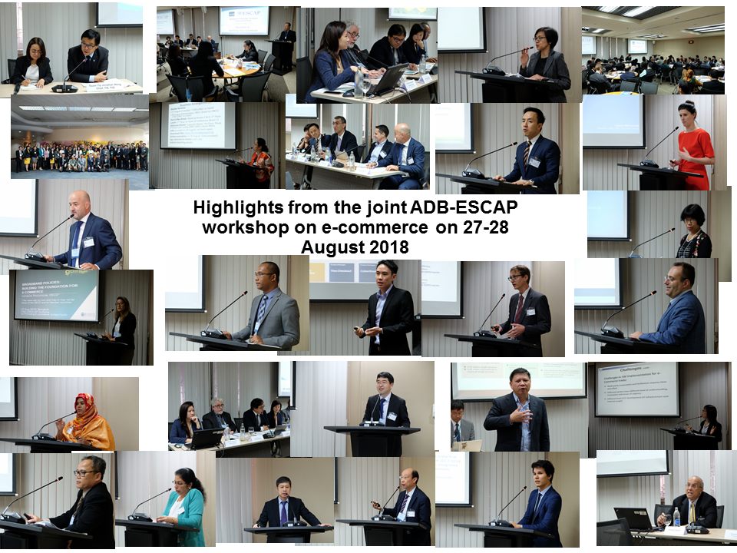

Slide 17
Topics discussed on e-commerce during the workshop
1. Landscape and
Overview
2. Legal and
regulatory
environment
3. Tax
4. Payment
5. Cross-border
E-commerce
6. Technology
7. Group discussions
Notes:
Creating an enabling legal environment involves enacting new laws as well as revising existing legal provisions.
The legal issues to be taken into account includes:
1. Legal basis for establishing a Single Window
2. Legal validity of electronic document
3. Issue of liability
4. Data protection
5. e-Archiving of trade data
6. Data quality
7. Data access authority
8. Competition
9. Arbitration and dispute resolution
10. Intellectual property right and data ownership
11. Single Window structure and organization, and
12. Identification, authentication & authorization

Slide 18
Some key messages from the workshop (1)
Mobile penetration rates are increasing across Asia. In Myanmar mobile penetration rose from 2.5% in 2011 to 97.5% in 2016, a sim card costed US$300 in 2012 while the price dropped to US$1.50 today.
In the Philippines, e-commerce has been identified as an important component in the Micro, Small, and Medium Enterprise (MSME) Development Plan 2017-2022.
Indonesia has recently launched an e-commerce road map.
In China, “Internet Plus“ has been applied to support agricultural e-commerce.
In China, 15 cities have been identified to be the national pilot cities for cross-border e-commerce retailing import business while 35 cities have been identified to be the national cross border E-trade Pilot Zone.

Slide 19
Some key messages from the workshop (2)
In Bangladesh, mobile financial services offer an innovative way to promote financial inclusion for e-payments to the majority of people who don’t have bank accounts.
A few sea ports and terminals in the region such as Hong Kong, Singapore, Sydney, and Manila are participating in a blockchain project led by IBM and Maersk.
The Alibaba e-commerce ecosystem is maturing and providing more convenience to its customers.

Slide 20
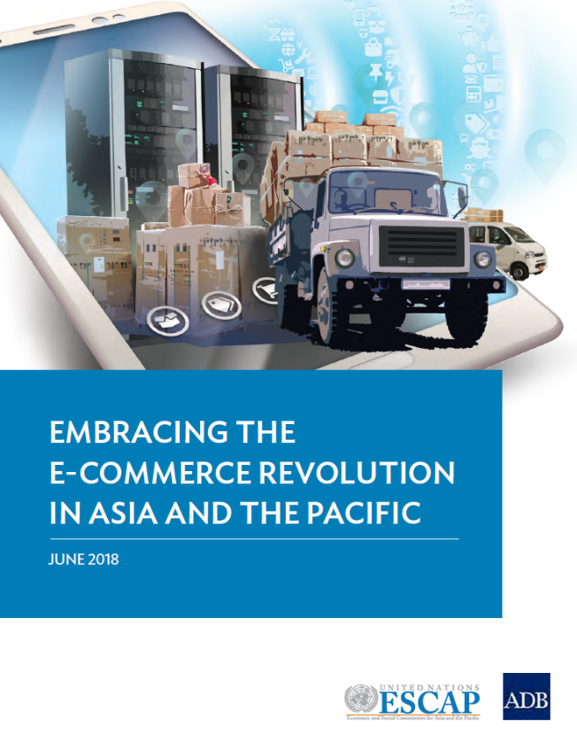
Thank you!
https://www.unescap.org/resources/embracing-e-commerce-revolution-asia-and-pacific

