Slide 1

Realizing the Potential of e-Commerce for Development
Virginia Cram-Martos
Director, Economic Cooperation
and Trade Division, UNECE

Slide 2
Impact for Development

Slide 3

Notes:
The synergies between e-commerce (new technologies) and trade facilitation can contribute to reaching most, if not all, of the sustainable development goals

Slide 4
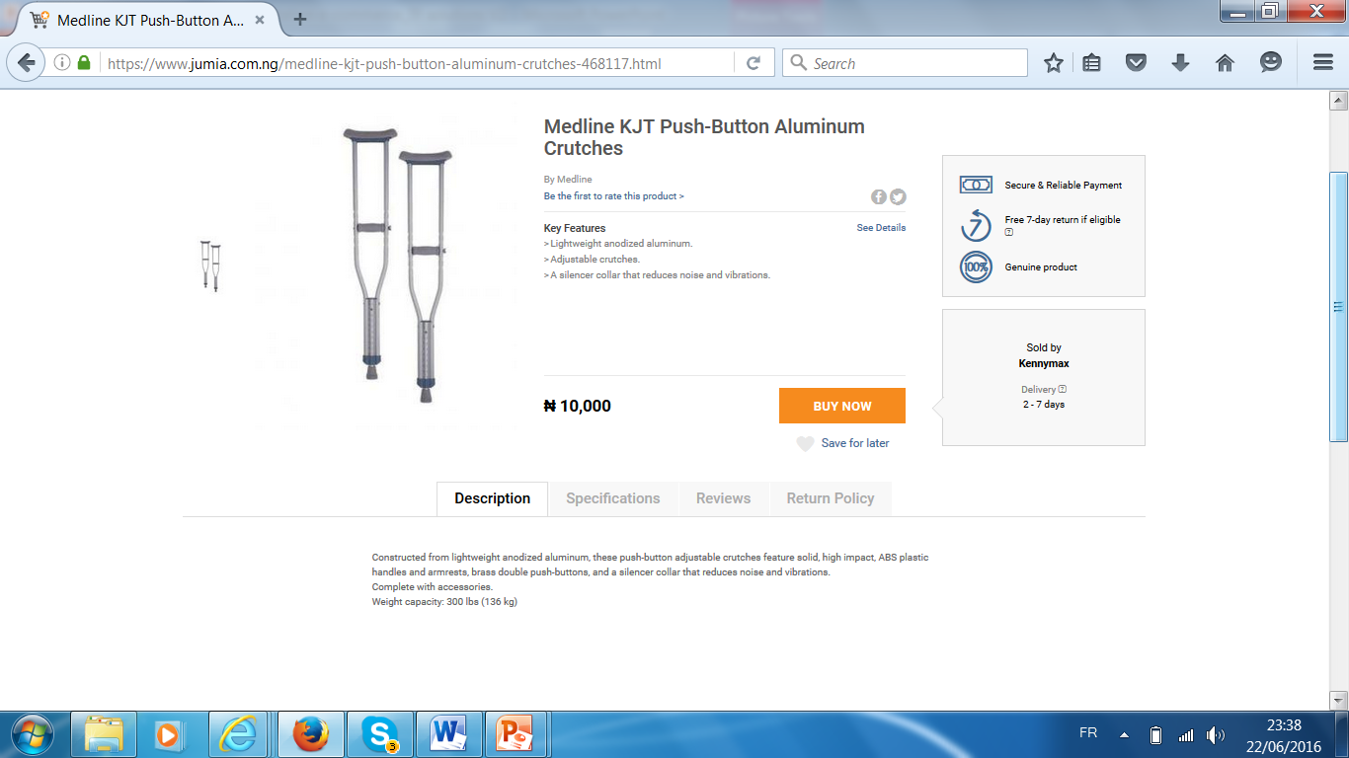

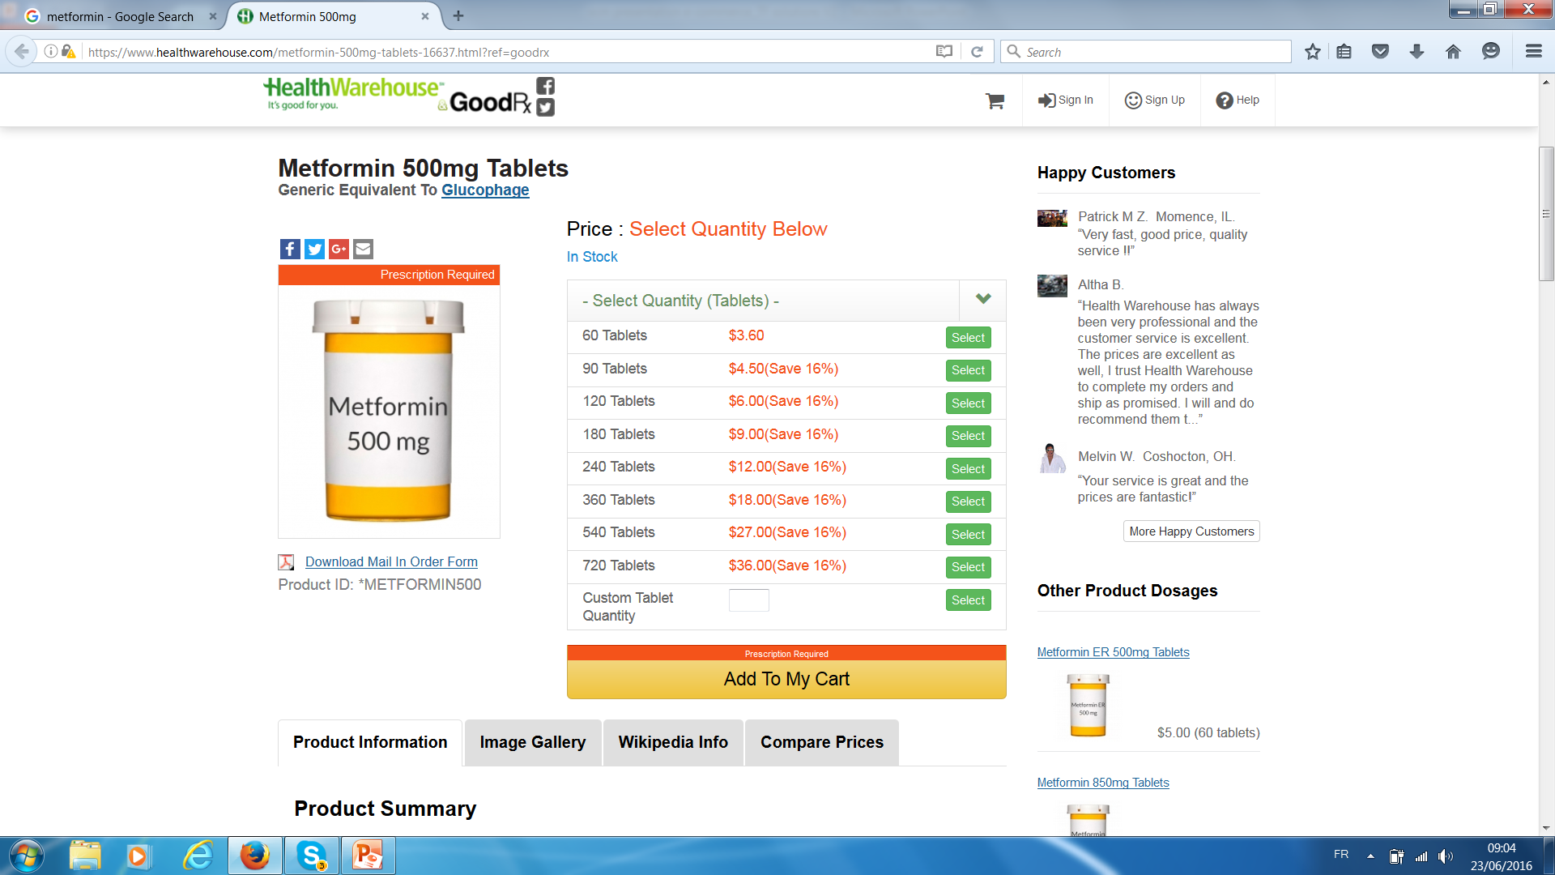
Increases
access to products that improve quality of life
Medication
for type 2 diabetes
Notes:
Especially for those in remote areas or with special needs
For example, it could make good quality planting seed or agricultural tools available in rural areas
Or
Medical equipment, such as wheelchairs and crutches,
and eventually even medication

Slide 5
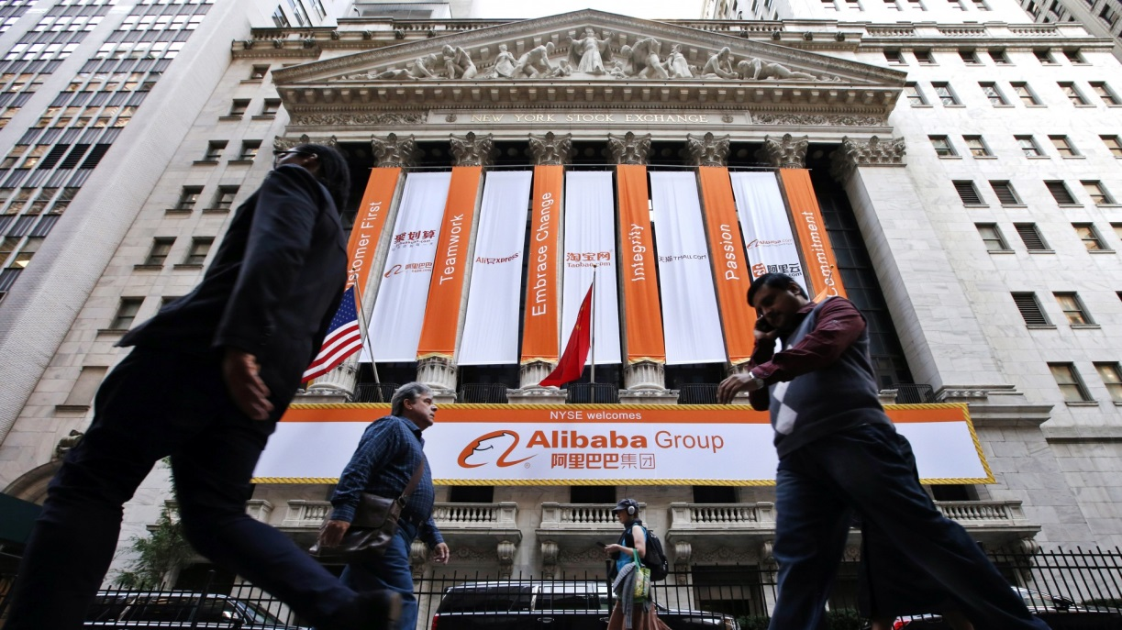


Creates direct employment and poverty reduction
Notes:
Amazon (20 years on the Internet)
Amazon has 240,000 employees
20,000 people work at Amazon headquarters in Seattle.
It has offices in more than 30 countries around the world
Alibaba
As of March 2016, the Chinese e-commerce corporation had 36,450 full-time employees, up from 34,985 in the previous year. The majority of employees are based in China.
Jumia is based in Africa and has developed a commission-based sales force
to encourage use of e-commerce
Benefits Jumia posts on its sales force recruiting site:
You make commissions selling items supplied by Jumia.
Your efforts are rewarded: the more you work, the more you earn!
You also earn money for each new sales consultant you recruit!
As an independent sales consultant, you have complete freedom and control over your activity.
Build your own successful business. The sky is the limit !

Slide 6
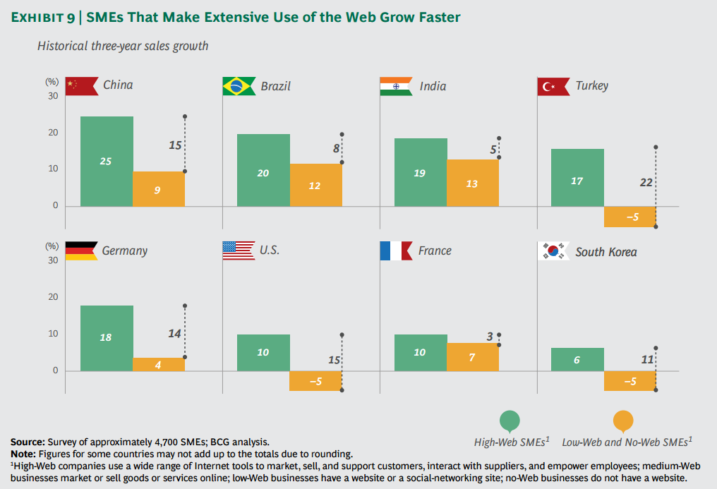
Supports SMEs development and, thus, economic diversification and development
Notes:
In 2012, a study on G20 economies (BCG study) surveyed 15,000 SMEs operating in the world biggest economies.
Across 11 of the G-20 countries, high web SMEs have experience revenues growth that was up to 22% higher than that achieved by SMEs with low or not use of the web over the last three years. In the UK sales at high web SMEs increased 6 times as fast as revenues at firms with no Internet presence
As to employment, the same study shows that high and medium web SMEs generate more jobs. For instance, in Germany, 93% of High web SMEs and 82% of Medium web SMEs increased employment over the last e years, compared to 50% of non-web companies. Japan experienced similar result. In South Korea, employment increased at 94% in high-web SMEs and at 60% in non-web companies.
The economic changes brought by e-commerce have already contributed to the Asia Pacific region becoming the dominant region in the global economy, growing faster than any other at a rate of 35.2% year on year, and with projected total online sales of $875 billion in 20152
A study of Internet penetration in South Africa conducted by World Wide Worx found that 20% of formal, registered SMEs could not exist without their websites.

Slide 7




e-Commerce
Effective driver for inclusive trade
Social media empowerment
Notes:
To summarise, e-commerce offers potential benefits such as:
Enhanced participation in international value chains
Increased market access for companies and increased access to products for consumers
Improved internal (company) and market efficiency
Lower transaction costs
According to the UNCTAD Information Economy Report 2015, benefits from e-commerce have expanded due to the following reasons:
Improved connectivity as a result for the widespread uptake of mobile telephony and social media
New applications, platforms and services making e-commerce more accessible
Local companies providing e-commerce solutions are rapidly appearing in developing countries Example:
Alibaba Groups (Chinese e-commerce enterprise), it initial public offering in the NY Stock Exchange was the world largest ever (raising 25 billions USD)
Jumia (African online retailer) is expanding to Cameroon, Ghana and Uganda, complementing its operations in Cote d’Ivoire, Egypt, Kenya, Morocco and Nigeria

Slide 8
Challenges

Slide 9
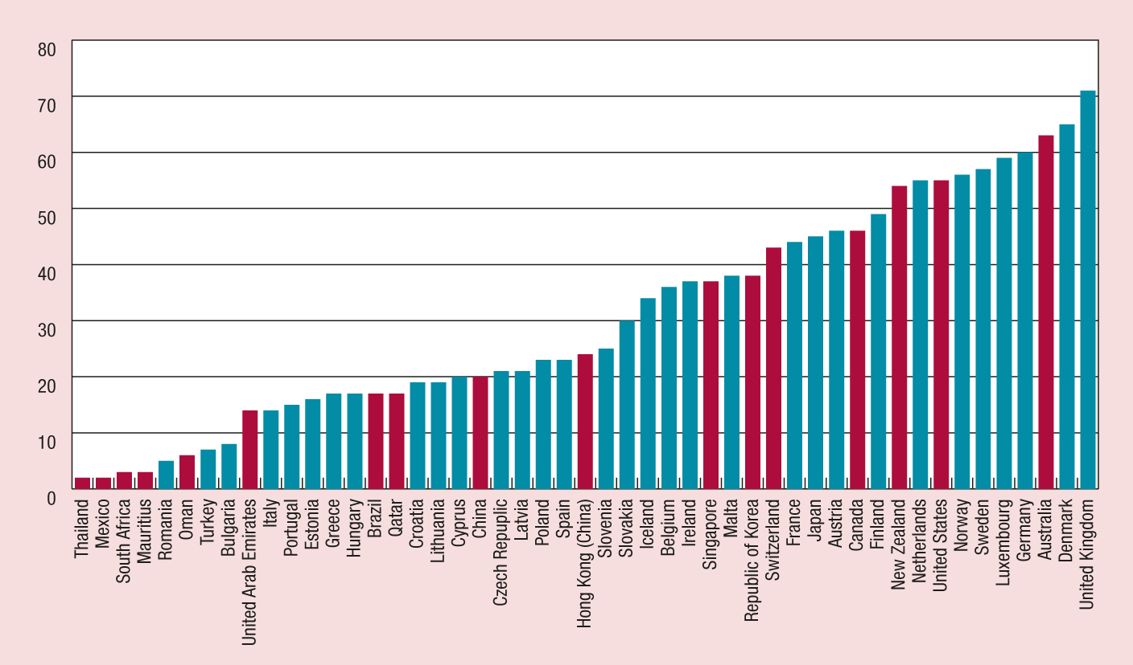
The e-commerce divide is still huge
Share of individuals purchasing online 2013
Source: UNCTAD, based on Eurostat, ITU and national data (in red).
Notes:
There are many barriers to e-commerce uptake
Limited use of the Internet among businesses and consumers
Lack of awareness among governments and regulators
Concerns about possible adverse effects
Insufficient access to affordable ICT infrastructure
Inadequate trade logistics and facilitation
Lack of security and trust in online transactions
Inadequate online payment facilities
Lack of trade finance
Limited e-commerce skills among enterprises
Absence of statistical data on e-commerce
Weak legal and regulatory frameworks

Slide 10
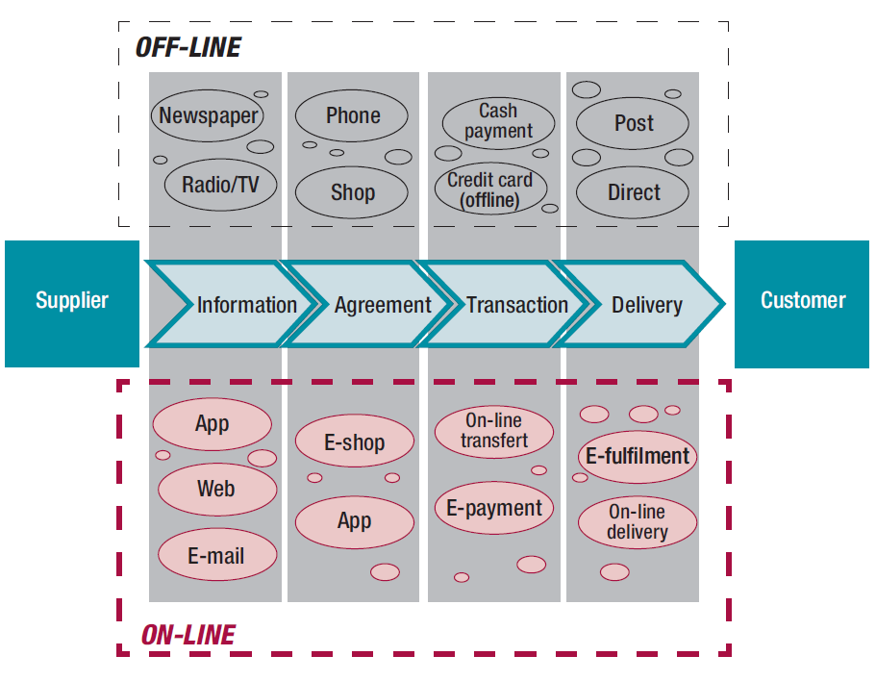
e-Commerce transaction value chain
Source: UNCTAD, 2015
Notes:
The shift towards e-commerce is already transforming the behaviour of businesses and consumers.
The role of ICT applications and services is expanding across the entire value chain of e-commerce.
The e-commerce process supply chain can be divided in 4 stages:
information gathering: internet browsing, emails and social networks help consumer to compare products and prices
Agreement: online application solutions replace the physical visit to the shop
Transaction: e-payment solutions replace paying by bash or credit car at the shop
Delivery: Some products can be delivered digitally (ebooks) or physically (shipping a book). The last shipping method represents a challenge (but at the same time an opportunity) for ecommerce. It will be discussed in the following slides
A study of e-commerce in the EU found that enhanced choice from buying online rather than offline was a more important contributor to increased welfare gains for consumers than lower prices.
According to the OECD, the consumer surplus from the Internet in the G-20 countries was estimated in 2012 to average about 1,430 USD per person, or about 4.4% of the GDP.

Slide 11

A key e-Commerce challenge
goods are still delivered physically
Notes:
According the UNCTAD Information Economy Report 2015, the extent to which people purchase goods and services online varies considerably among countries, ranging from less than 2 % of people in some middle-income countries to more than 70 % United Kingdom of Great Britain and Northern Ireland.
Challenge:
Trade logistics as well as cross-border facilitation measures remain key for any international e-commerce transaction related to goods.
For some developing countries’ trade and, transport costs are still prohibitively high.
Most traders would like to have access to a single window, a global standardized de minimis regime, full tracking of all shipments, predictable delivery times, fully transparent procedures and duties via websites and enquiry points, warehouse consolidation for MSMEs in the export market and the possibility to make electronic payments to customs.

Slide 12
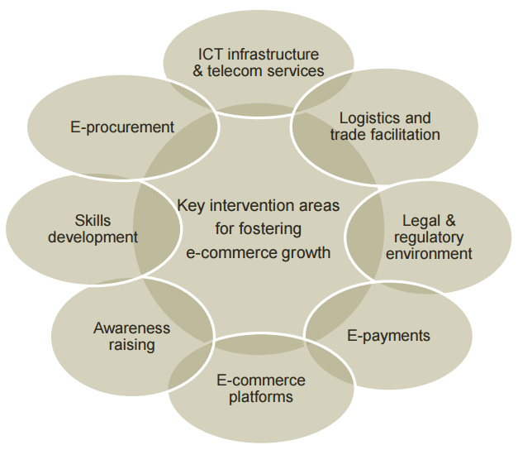
e-Commerce enabling framework
Source: UNCTAD

Slide 13
What is Trade Facilitation?
TRADE FACILITATION
Simplification
Harmonization
Standardization
Process of eliminating all unnecessary elements and duplications in formalities, processes and procedures
Alignment of national procedures, operations and documents with international conventions, standards and practices
Process of developing internationally agreed formats for practices and procedures, documents and information

Slide 14
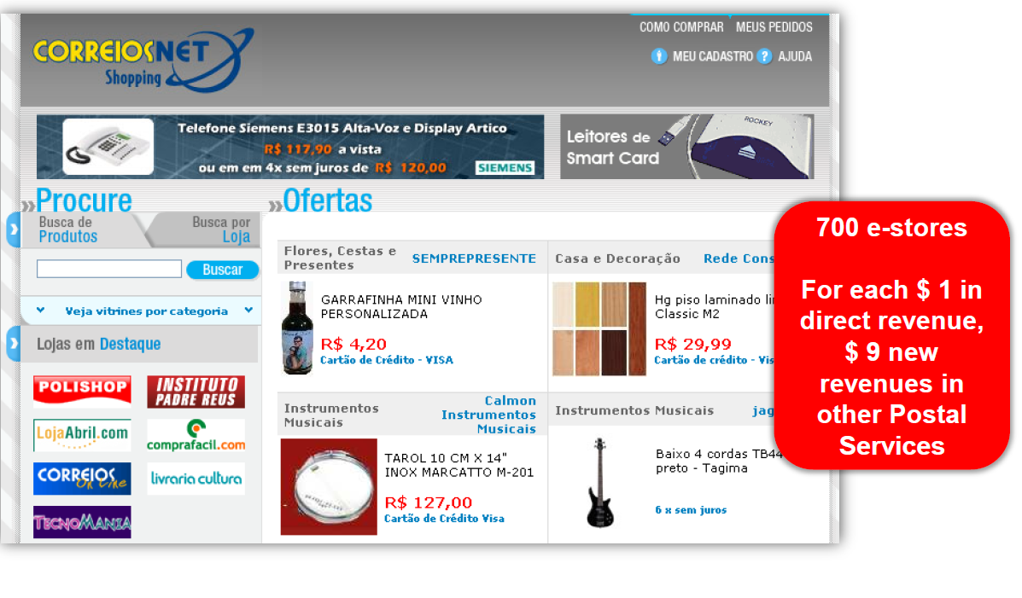
Postal Services can be key partners in bridging the e-commerce divide for SMEs
Brazil case
Notes:
Information available on the site of Brazilian post: Prices and Delivery Times Postal Code Pickup Requisition Track & Trace Reverse Logistics
Shipping Label Printing Shipping Preparation Complaint Processing

Slide 15
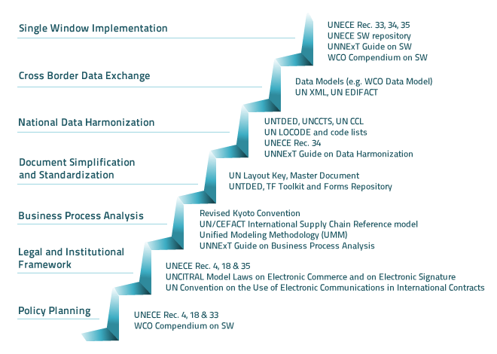
Standards are a Key to Progress
Notes:
It is important to bear in mind that the establishment of a Single Window system is a complex political reform project with several challenges that go beyond technological and financial issues. The planning phase is a critical one. In terms of sequence of steps, first simplify the processes (and eliminate steps where possible) , and change the legal framework, and then automate the simplified processess, integrate the key agencies (Customs, OGAs, etc). An automated customs system is often the first step. In practice, this is an iterative process
Policy makers and managers need a strategic and holistic framework that helps them to systematically address all these challenges and to effectively manage the project.
UNECE Recommendation No. 33 provides useful guidance with regards to the preparatory work and the various policy documents that may have to be developed The WCO Single Window Compendium also cover the policy and project management aspects UNECE Recommendation No. 4 and Recommendation No. 18 outline the framework for the necessary trade government collaboration.
A supportive legal framework and reliable institutional platform for inter-agency collaboration and stakeholders consultation.
Exchange of data amongst the participating parties of a SW requires a legal framework that enables and defines the conditions of, amongst others, the electronic submission of documents, electronic signatures, user authentication, data sharing and data archiving. UNECE Recommendation No. 35 and the WCO Single Window Compendium identify releavnt legal issues , such as privacy and data protection issues. The UNCITRAL Model Law Electronic Commerce, the Model Law on Electronic Signatures , the UN Convention on the Use of Electronic Communications in International Contracts (2005), and a Guidance Text on the International Use of Authentication & Signature Methods are also key tools. UNNExT has also just published a Legal Guide for Electronic Single Window and Paperless Trade
Data and business interoperability,

Slide 16
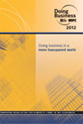


Single Window: a growing trend
“ Single Windows are important drivers for the simplification, harmonization and automation of trade procedures”
2005: in 20 economies
2010: in 49 economies
2012: in 71 economies
2015: in 100 economies & some regions (ASEAN)?
Source: WB Doing Business Report 2012/2013, UNECEUN/CEFACT 2005/2011
Notes:
According to the newly published WB Doing Business 2013 report, “Over the past few years, automation has played an important part in facilitating the processing and clearance of goods in many economies”.
Single Windows are important drivers for the simplification, harmonization and automation of trade procedures.
This is witnessed by the rapidly increasing number of countries, especially developing countries and transition economies that over the last 10 years put in place their SWs.
At the UNECE SW conference of 2005, it was said there were about 20 economies with a SW in place. In 2011 the Doing Business Report identifies 49 countries as having a SW, of which 20 have one that connects all government agencies. The 2013 Doing Business reports that they are already 71,
It is important to bear in mind that the establishment of a Single Window system is a complex political reform project with several challenges that go beyond technological and financial issues. The planning phase is a critical one. In terms of sequence of steps, first simplify the processes (and eliminate steps where possible) , and change the legal framework, and then automate the simplified processess, integrate the key agencies (Customs, OGAs, etc). An automated customs system is often the first step. In practice, this is an iterative process
Policy makers and managers need a strategic and holistic framework that helps them to systematically address all these challenges and to effectively manage the project.
UNECE Recommendation No. 33 provides useful guidance with regards to the preparatory work and the various policy documents that may have to be developed The WCO Single Window Compendium also cover the policy and project management aspects UNECE Recommendation No. 4 and Recommendation No. 18 outline the framework for the necessary trade government collaboration.
A supportive legal framework and reliable institutional platform for inter-agency collaboration and stakeholders consultation.
Exchange of data amongst the participating parties of a SW requires a legal framework that enables and defines the conditions of, amongst others, the electronic submission of documents, electronic signatures, user authentication, data sharing and data archiving. UNECE Recommendation No. 35 and the WCO Single Window Compendium identify releavnt legal issues , such as privacy and data protection issues. The UNCITRAL Model Law Electronic Commerce, the Model Law on Electronic Signatures , the UN Convention on the Use of Electronic Communications in International Contracts (2005), and a Guidance Text on the International Use of Authentication & Signature Methods are also key tools. UNNExT has also just published a Legal Guide for Electronic Single Window and Paperless Trade

Slide 17

e-Phytosanitary Certification
Exchanged electronically
ePhyto Hub
Streamlining trade
Notes:
All the information contained in a paper phytosanitary certificate is also in the ePhyto electronic message.
Benefits of a globally harmonized approach for ePhyto through an international hub:
Globally harmonized approach for electronic phytosanitary certification (ePhyto) in accordance with an adopted International Standard for Phytosanitary Measures (ISPM) 12 Phytosanitary Certificates;
Reduced potential for fraudulent certificates;
Reduced data entry and validation activities by national plant protection organizations (NPPO) improving efficiencies;
Improved security in the transmission of certificates when compared with paper certificates;
Efficiencies in arrival and clearance of plants and plant products at the point of entry;
Reduced delays in receiving replacement phytosanitary certificates when required;
Use of existing systems in facilitating electronic certification reduces development costs;
Avoids bilateral agreements required for direct NPPO to NPPO transfer of electronic certificates;
Potential to link with the World Customs Organization “Single Window” initiative and to harmonize codes and processes; and
Use of harmonized international e-business standards between governments (using UN/CEFACT standards) is a key element to trade facilitation within the e-commerce field.

Slide 18
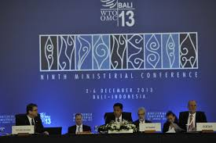


WTO Trade Facilitation Agreement
Special and differential treatment framework
Great investment returns
- 1 day to export/import
…..+ 4% international trade
- 4 days to export/import
….+ 0.1 % GDP per capita growth rate
&
Source: WTO 2012, OECD 2012, WB DB Report 2013
Notes:
In December 2013, the importance of trade facilitation was recognised by the WTO when its members concluded negotiations on a Trade Facilitation Agreement at the Bali Ministerial Conference,
As of June 2016, 81 Members had ratified the TFA
The Agreement contains two kind of provisions:
Substantive provisions: for expediting the movement, release and clearance of goods, including goods in transit.
B) Special and differential treatment provisions: for technical assistance and capacity building in this area
The Agreement contains unique special and differential treatment (SDT) measures that link the requirement to implement with the capacity of developing countries and least developed countries (LDC) to do so.
It is the only and the first WTO Agreement to do so
Why is TF a good investment option?
The more costly and time consuming it is to export or import, the more difficult it is for local companies to be competitive and to reach international markets.
This is well known and it is why trade facilitation is gaining increasing importance on the international political agenda
In the past 8 years Doing Business recorded 2012 trade facilitation reforms around the world. Thanks to these efforts, trading across borders has become faster and easier.
In 2006 it took 26 days on average to export and 31 days to import a standardized cargo of goods by ocean transport (with every official procedure recorded but actual time in the ocean excluded).Today it takes only 22 days on average to export and 25 to import.
Analysis shows that such gains have had positive effects.
A reduction of 1 day in the time to trade across border, increases international trade by 4%.
And a reduction of 4 days in the time to trade across borders is linked to an increase in the per capita growth rate of 0.1 percentage point (matching the data available since 2005 on the time to trade across borders with GDP per capita growth data)
According to the WTO, all regions are expected to experience reductions in trade costs, with Africa (16.5 per cent) benefitting the most. Comparisons of the anticipated impact of TFA implementation on different income groups suggest that least-developed countries (LDCs) will see the biggest reduction in trade costs (16.73 per cent).
In the following slides, we will see which TF measure could have a positive impact on e-Commerce

Slide 19
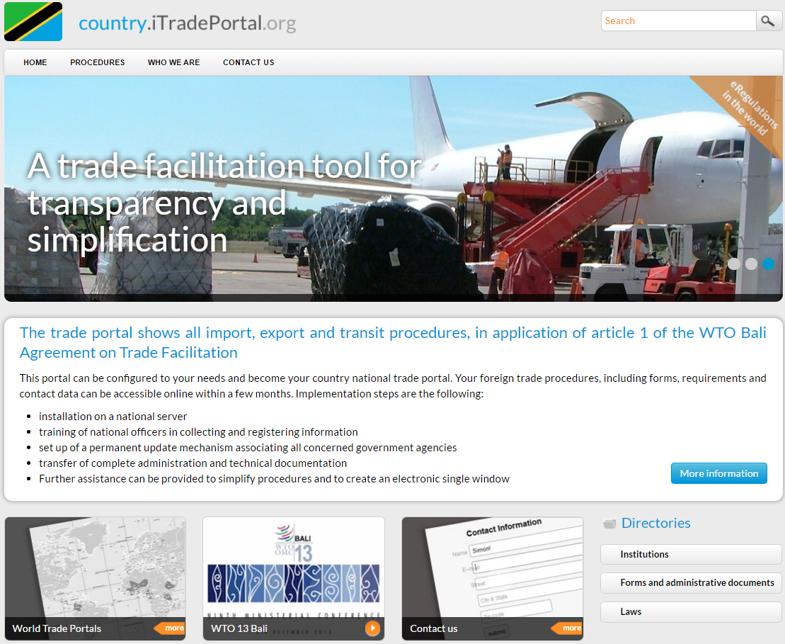
Trade portals
Notes:
Trade portal which show all import, export and transit procedures are required under article 1 of the WTO Bali Agreement on Trade Facilitation
This can be an important tool to support e-commerce by supporting transparency in the rules and regulations governing cross-border e-commerce transactions
Information portals are more difficult to establish and maintain than it appears at first glance, at the same time they can be extremely useful to traders, including those using e-commerce.
The complexity of Information Portals rests in the need to:
- Collect information from a very wide range of ministries and government departments (often more than 20)
- To update the information in a timely manner from all of these government ministries and agencies, so that changes affecting trade are available before taking effect
Present the data in a way that is easy to use and understand

Slide 20
Resources
Notes:
Trade portals represent a resource at a national level, there are also international resources available

Slide 21
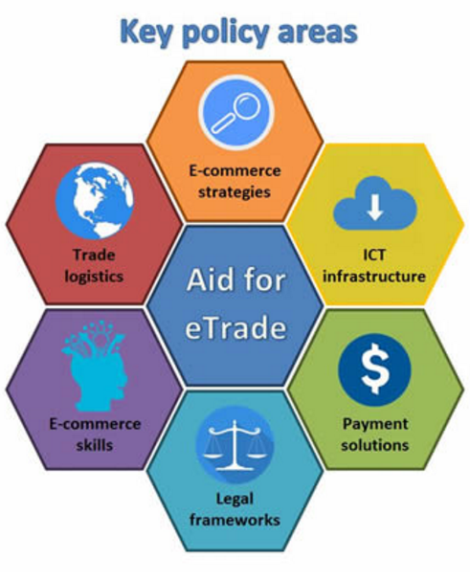
eTrade for All
To raise awareness
To mobilize resources
To strengthen coherence & synergies
UNCTAD, 2016
Notes:
e-trade for All is an initiative launched by UNCTAD in April 2016.
As of today, efforts from development partners, foundations, and private sector are:
seldom holistic or
systematically focused on building e-commerce economies.
Aid for eTrade is intended to be :
a multi-stakeholder initiative to improve the ability of developing countries and countries with economies in transition to use and benefit from e-commerce.
a demand-driven mechanism in which leading development partners cooperate with the private sector to pool capabilities and resources.
The goals of the initiative are as follows:
To raise awareness of opportunities and challenges related to leveraging e-commerce.
To mobilize and rationalize financial and human resources to implement e-commerce projects in developing countries.
To strengthen coherence and synergies among partners' activities with a view to avoiding duplication of work and enhancing aid efficiency.

Slide 22

A web-based, interactive knowledge management tool Available in Arabic, English, French, Russian and Spanish
2 new Itineraries
  Setting up a National Trade Facilitation Body
  Developing a National Trade Facilitation Roadmap
Updated information on TF Organizations
New case stories
Updated brochure and training materials
330,000 unique visitors
6.7m hits from 170 countries in 2015
tfig.unece.org
Notes:
Was developed in cooperation with 11 international organizations

Slide 23
What does «inclusive trade» mean?
Notes:
Against this background, now we have to answer the following question

Slide 24


It doesn’t mean to provide
equal treatment
It means to provide different treatment to equally reap the benefits of international trade

Slide 25
Be Proactive…..
Invest in trade facilitation
Seize capacity building and technical assistance opportunities
Build public-private partnerships

Slide 26

THANK YOU
You are invited to contact us at
trade@unece.org

